Slide 1
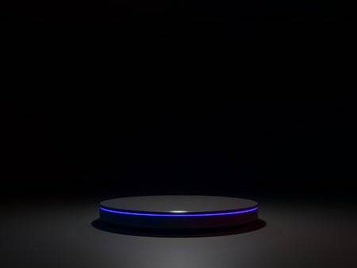

WORLD’S FIRST
BAALA
85%
Accuracy
Starting from
03$
75%
Price reduced

